Slide 1

UNMANNED SUBMARINE DRONE
KATHIA CORONADO, DAMIANO FALANGA, EDBIN GONZALEZ-CALDERON, ALEXANDRA SANTELLI, AND VERONICA VALERIO

Slide 2
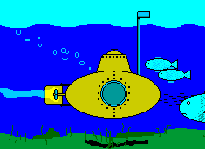
CREATING A SUBMARINE DRONE
Multi-disciplinary task
Fluids
CAD and FEA
Mechatronics
Solid Mechanics
Distinctive Design
Compact
Economical
Wireless
Notes:
VENEZUELA

Slide 3
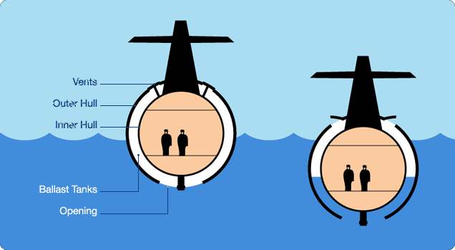
HOW DO SUBMARINES WORK?
Submarines control buoyancy to dive and resurface
Positive buoyancy
Air fills ballast tank
Negative buoyancy
Ballast tank takes in water
Neutral buoyancy
Buoyant force equals weight
Neither sinks or floats
To resurface
Compressed air expels water
Notes:
VENEZUELA

Slide 4
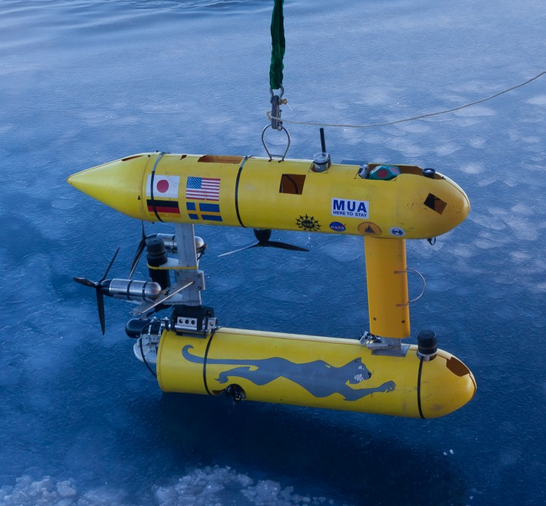
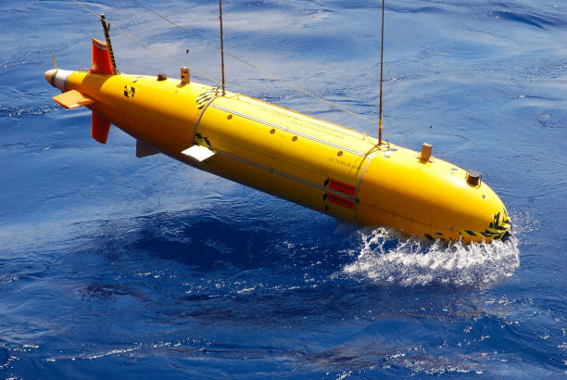
SUBMARINE DRONES
Unmanned Underwater Vehicles (UUV)
Recreational or professional use
Expensive
Autonomous Underwater Vehicles (AUV)
Useful for industry
Surveying infrastructure
Ocean mapping
Undersea mining
Deep sea drilling
Ship inspection
US Navy
Notes:
AMOEBA

Slide 5
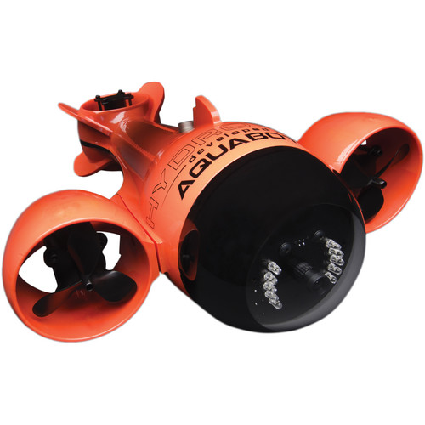
EXISTING DRONES
Aquabotix HydroView Sport RC Underwater Vehicle
$5800
150 ft depth
75 ft tethered cable
2-3 hour battery life
4.6 km/hr full forward speed, 1.8 km/hr full reverse speed
2 lb payload
Notes:
AMOEBA

Slide 6
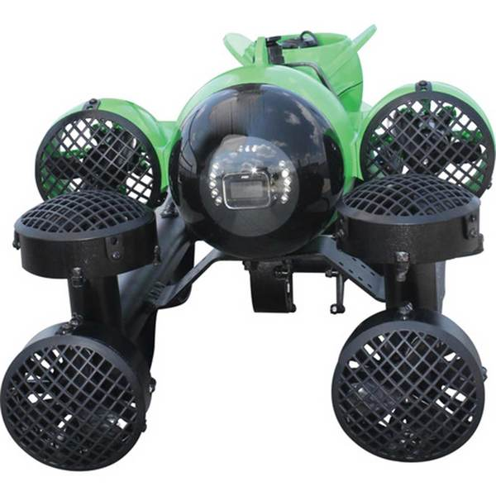
EXISTING DRONES
HydroView Pro 7M mini ROV
$16,900
250 ft depth
250 ft tethered cable
3 hour battery life
4.6 km/hr full forward speed,
2.3 km/hr reverse speed
Notes:
AMOEBA

Slide 7
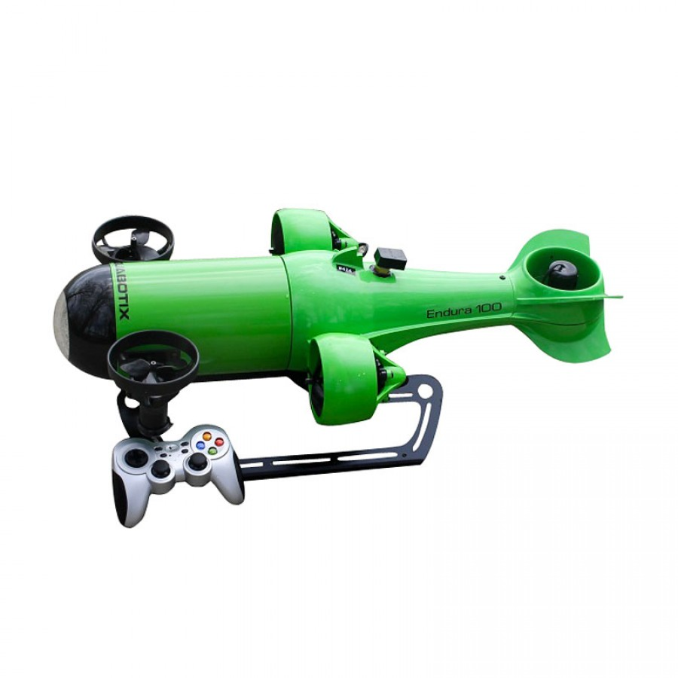
EXISTING DRONES
Endura 100 Mini ROV Underwater Vehicle
$29,000
328 ft depth
Up to 328 ft tethered cable
4 hour battery life
5.6 km/hr forward speed
4 lb payload
Notes:
AMOEBA

Slide 8
SPECIFICATIONS
Topics of Discussion | Specifications
Maximum Depth | 10 ft
Maximum Range | 32.8 ft
Speed | 5 ft/s
Payload | 2.2 lbm
Size | 6 in x 12 in
Cost | $500
Notes:
AMOEBA

Slide 9
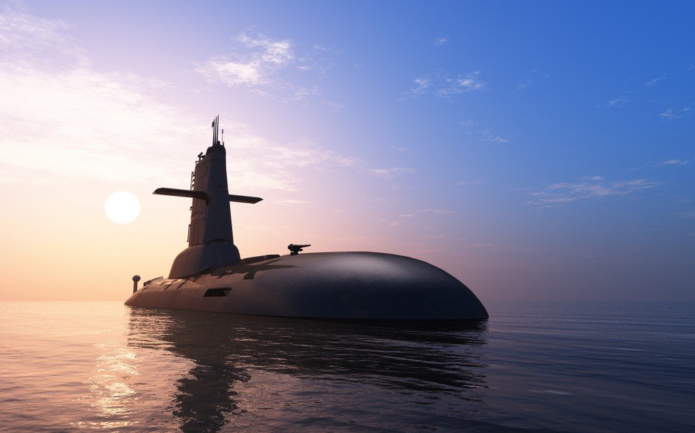
OBJECTIVES
Unmanned Underwater Vehicle
Remote Controlled
Wireless/Untethered
Cost Effective
Optimize performance
Minimize Cost
Unique Operating Envelope
Distinctive Communication System
Notes:
VENEZUELA

Slide 10
INITIAL DESIGN
Notes:
PLOP

Slide 11
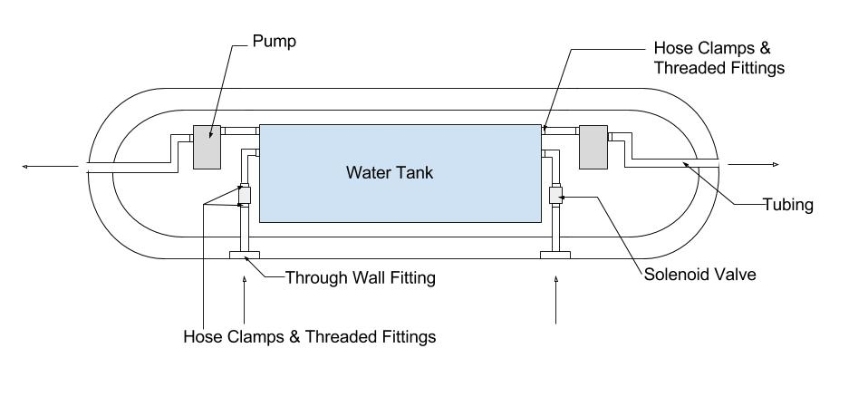
INITIAL DESIGN
Notes:
VENEZUELA

Slide 12
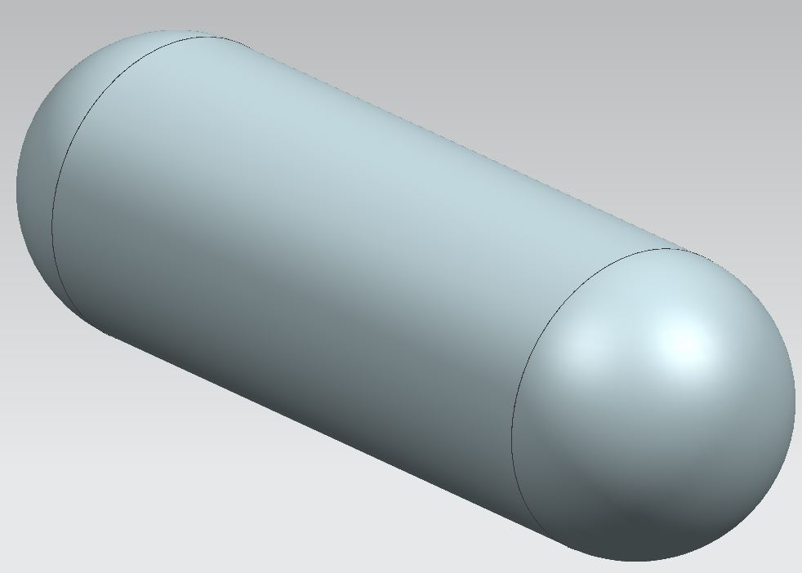
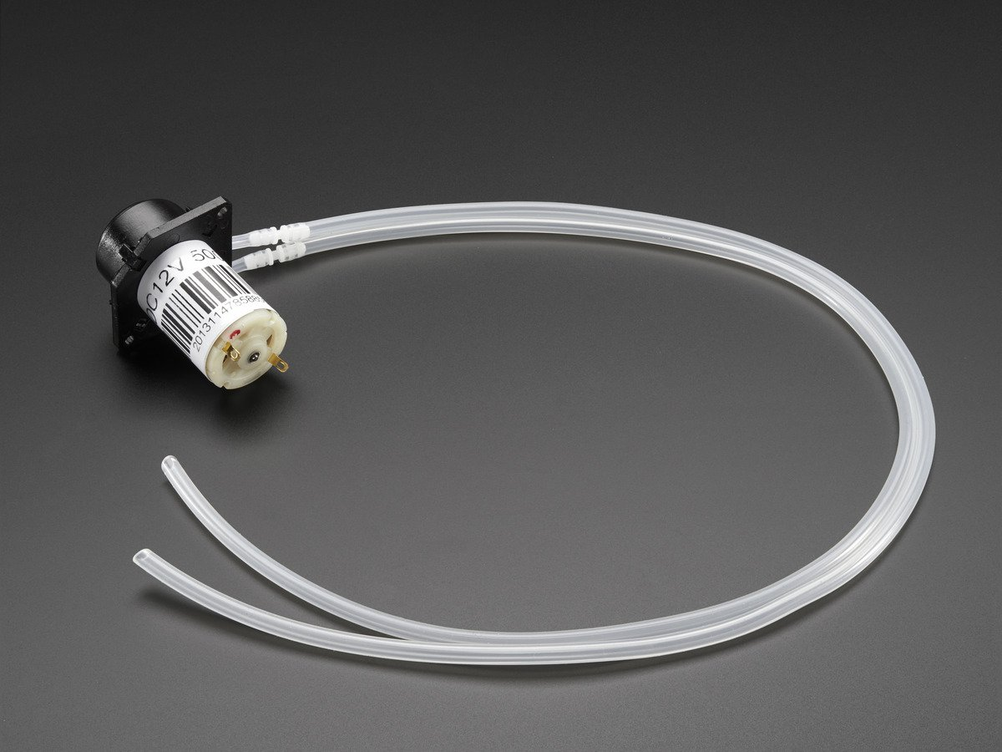
INITIAL DESIGN
Simple hull design
Utilize a pump for water intake and ejection
Solenoid valve to control flow
Easily accessible in the market; inexpensive
Design Challenges:
Hull too small to meet design requirements
Pump not strong enough to expel water at target depth; create vacuum in tank
Notes:
AMOEBA

Slide 13
SECOND DESIGN
Notes:
AMOEBA

Slide 14
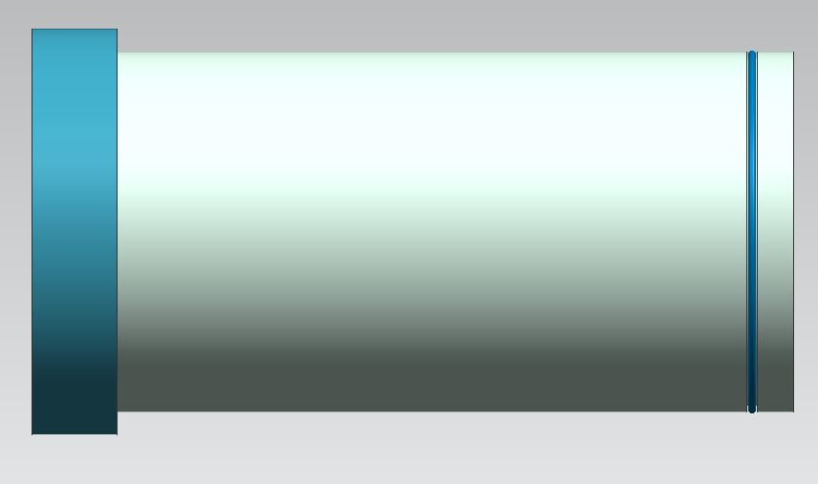
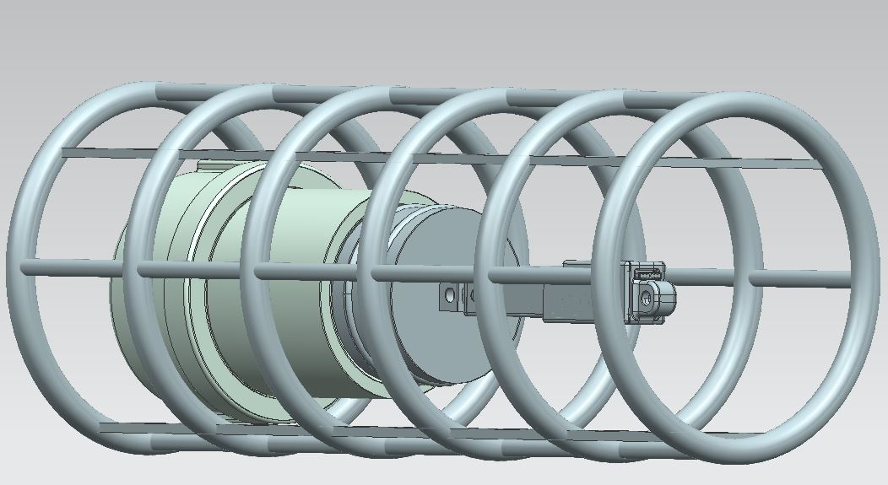
SECOND DESIGN
Cylindrical Hull
4-in nominal PVC pipe
11-in length
Inner Cage
Cylindrical cross-section
Used for ease of access to inner components
Ballast Tank
304 Stainless Steel
2-in nominal
Length of 3-in
Ballast Tank Cap
304 Stainless Steel
2-in nominal
Notes:
DAMINO

Slide 15
CURRENT DESIGN
Notes:
DAMINO

Slide 16
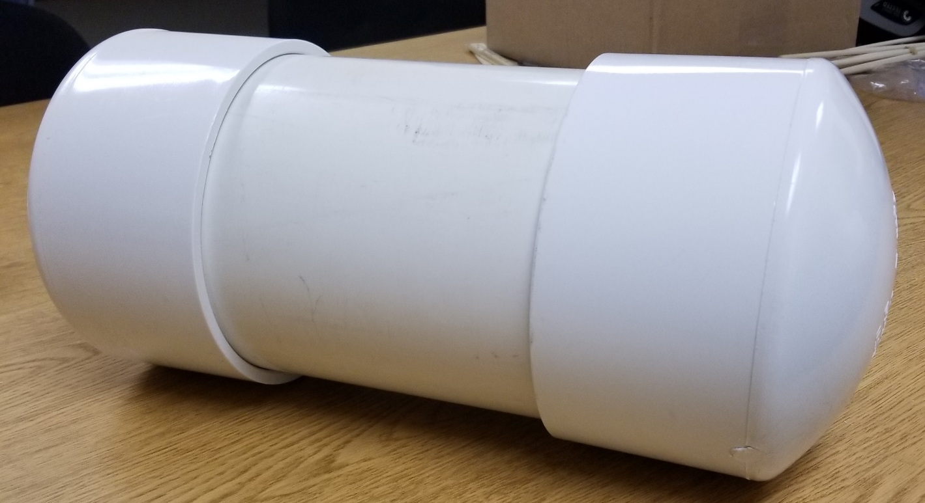
CURRENT DESIGN: HULL
PVC Pipe and End Caps 6-in nominal
Cylindrical Shape
Optimal shape for hydrostatics
Easier to obtain
Houses piston, actuator, and communication system
Notes:
DAMINO. Why cylinder. Explain--correct shape, easier to get. Also it’s been always been a cylinder. Should get picture of everything put together like the cage, circuit, etc

Slide 17
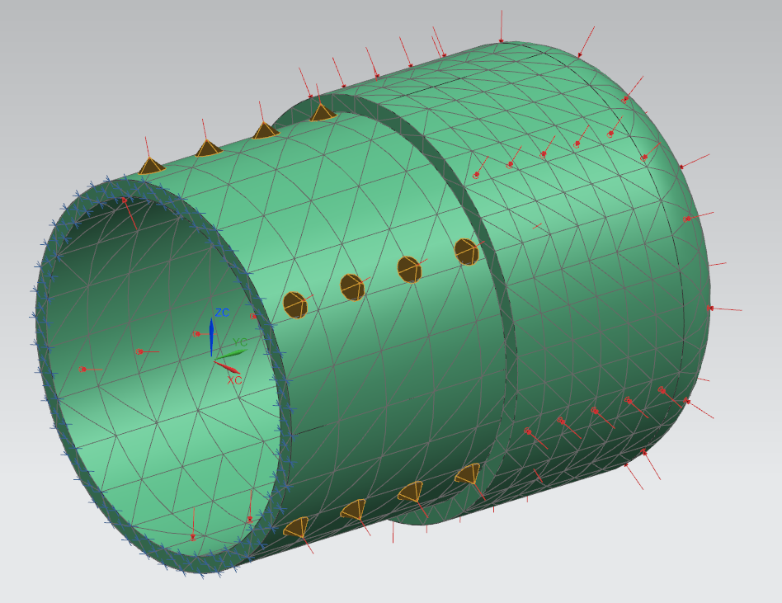
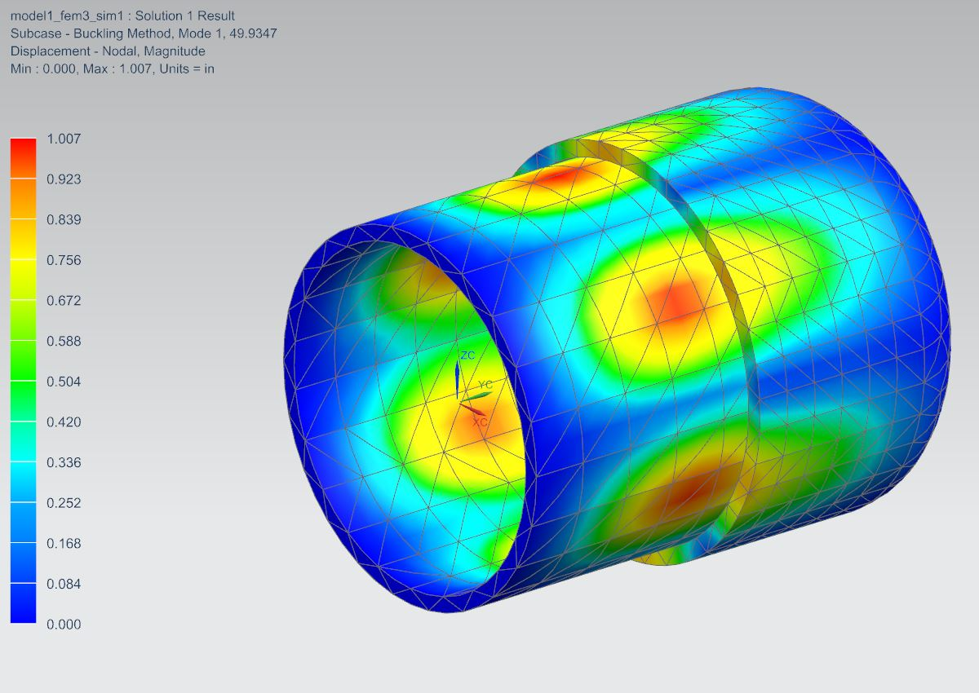
FAILURE ANALYSIS: HULL BUCKLING
Notes:
DAMINO Why did we need to do this? We need details. What does the factor of safety mean here

Slide 18
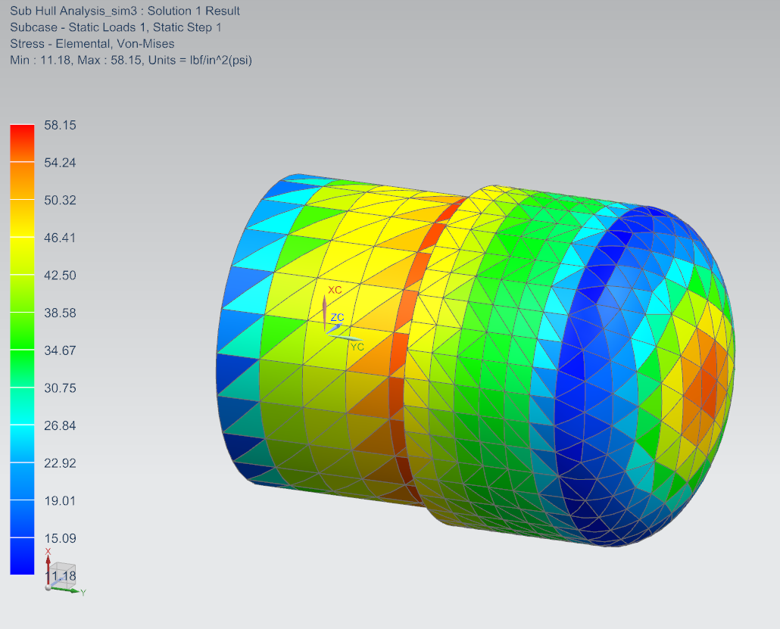
FAILURE ANALYSIS: STRESS
Notes:
DAMINO Again need more details. Whats happening how was it loaded etc. mesh size

Slide 19
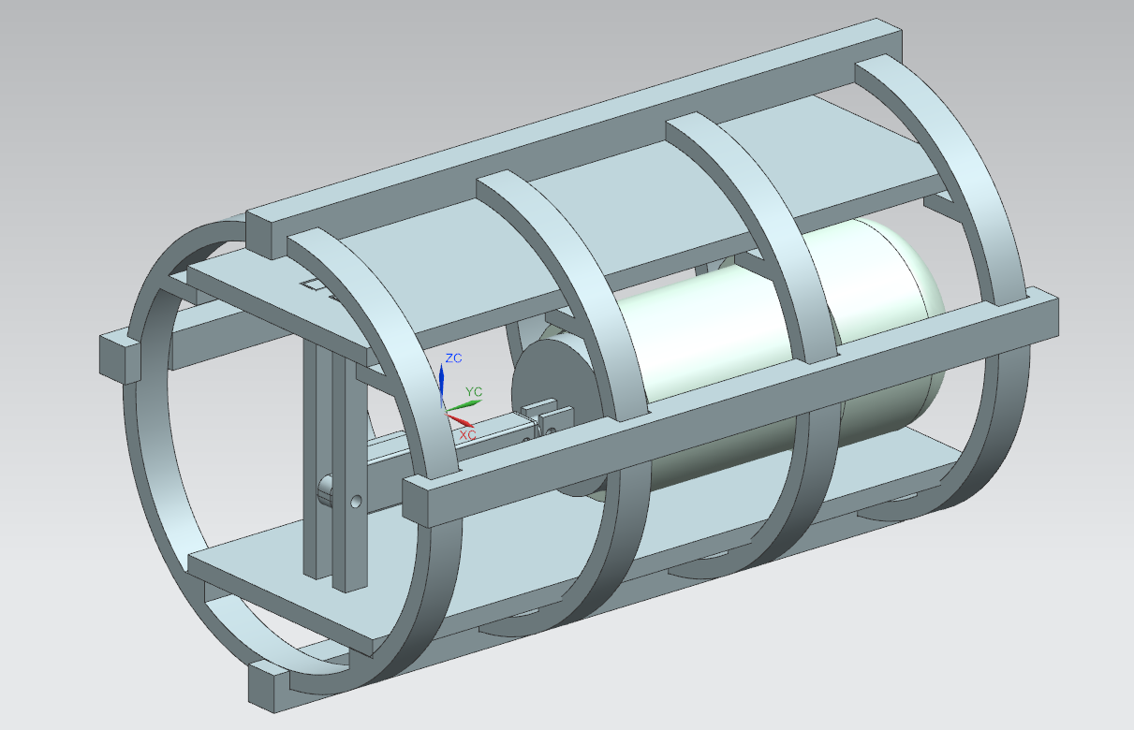
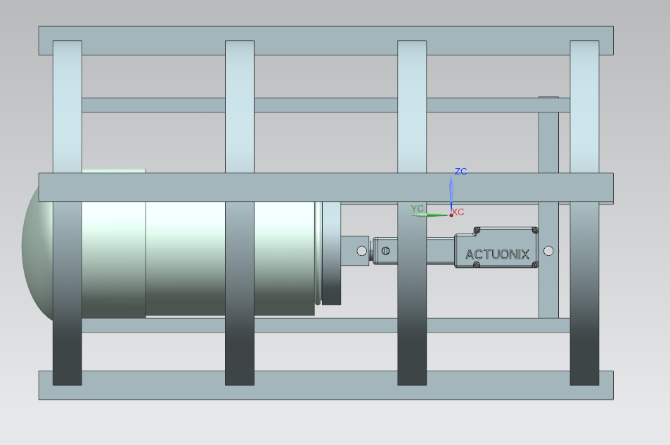
CURRENT DESIGN: HULL INTERIOR
3-D Printed Cage-like structure
Protects water ejection and communication systems
Shelves to secure electronic components
Easily removed for repair or adjustments
Notes:
ELBIN Indicate that this is final design. Maybe a slide with cad drawing, dimensions. Also maybe expand on this

Slide 20
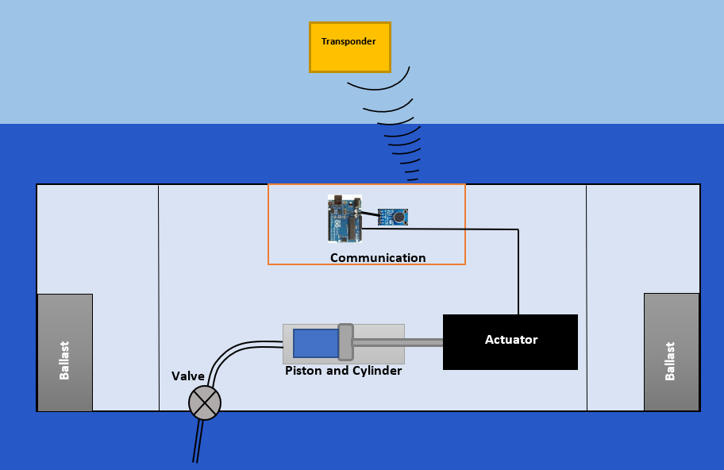
WATER EJECTION SYSTEM
Notes:
ELBIN

Slide 21
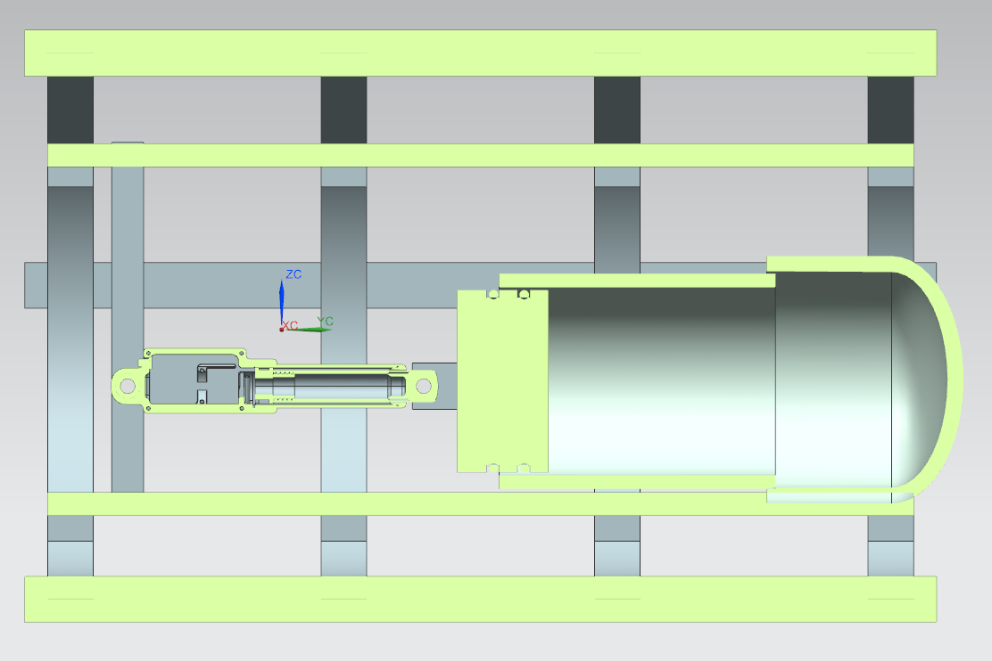
WATER EJECTION SYSTEM
PVC Pipe
PVC Pipe Fitting
Actuator
Piston
Notes:
ELBIN Actuator specs. Fe analysis of small pipe WILL IT BLOW UP???????????????????

Slide 22
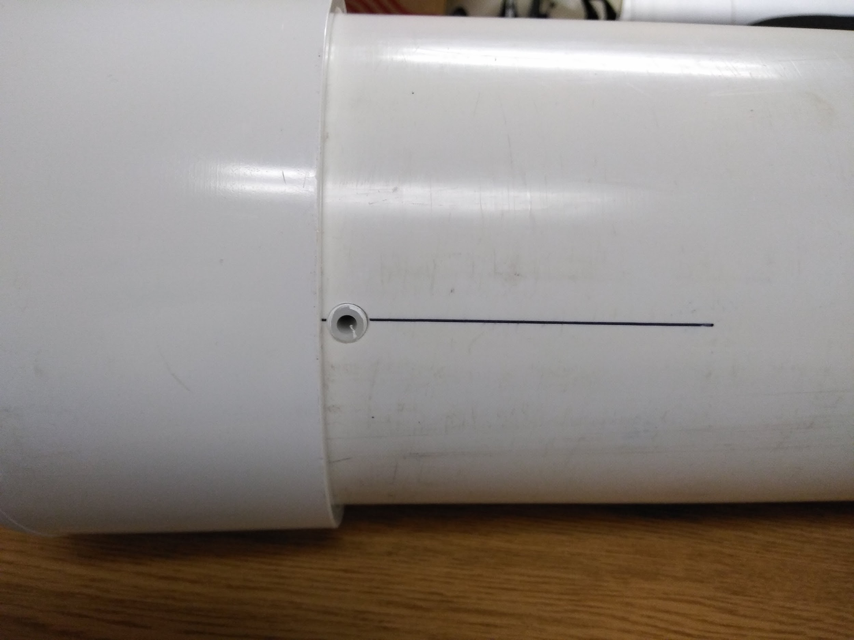
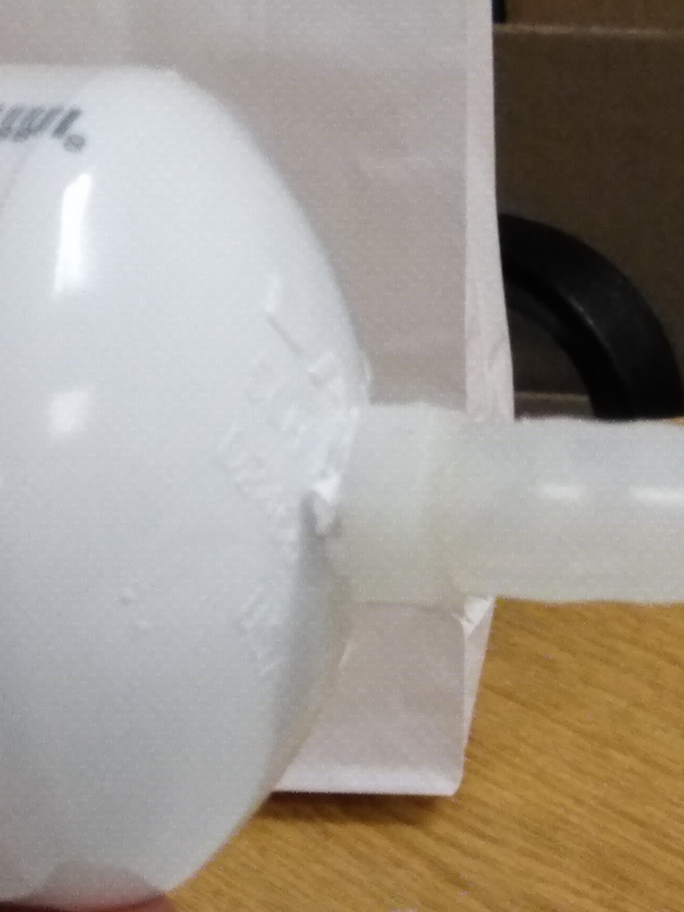
WATER EJECTION SYSTEM
Plastic barb fittings located on bottom of hull and ballast tank
¼ in diameter tubing with ⅛ NTP threading on fitting
Allows water to enter and exit the submarine
Notes:
ELBIN

Slide 23
PISTON & ACTUATOR SPECIFICATIONS
Ballast Tank Pipe
PVC
2 in nominal
4 in length
Ballast Tank Cap
PVC
2 in nominal
Actuator
Closed Length: 3.22 in
Stroke Length: 1.18 in
Voltage: 12V
Max Speed: 1 in per second
Piston
3-D Printed
Diameter: 2 in
Length: 1 in
Notes:
ELBIN

Slide 24
COMMUNICATION SYSTEM
Notes:
KITHA

Slide 25
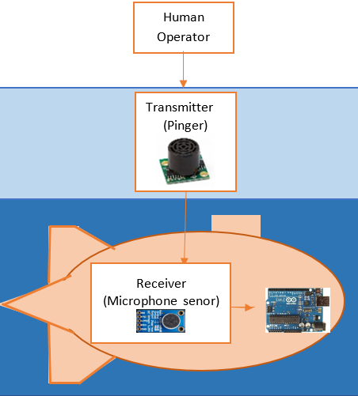
COMMUNICATION SYSTEM
Wireless Communication
Remote controlled from surface
Up, Down, Left, Right
User defined commands
Initial Considerations
Radio Frequency
Visible Light Communication (VLC)
Sound Navigation & Ranging (SONAR)
Custom SONAR System
Transmitter
Receiver
Notes:
KITHA maybe make a separate slide for that initial considerations?

Slide 26
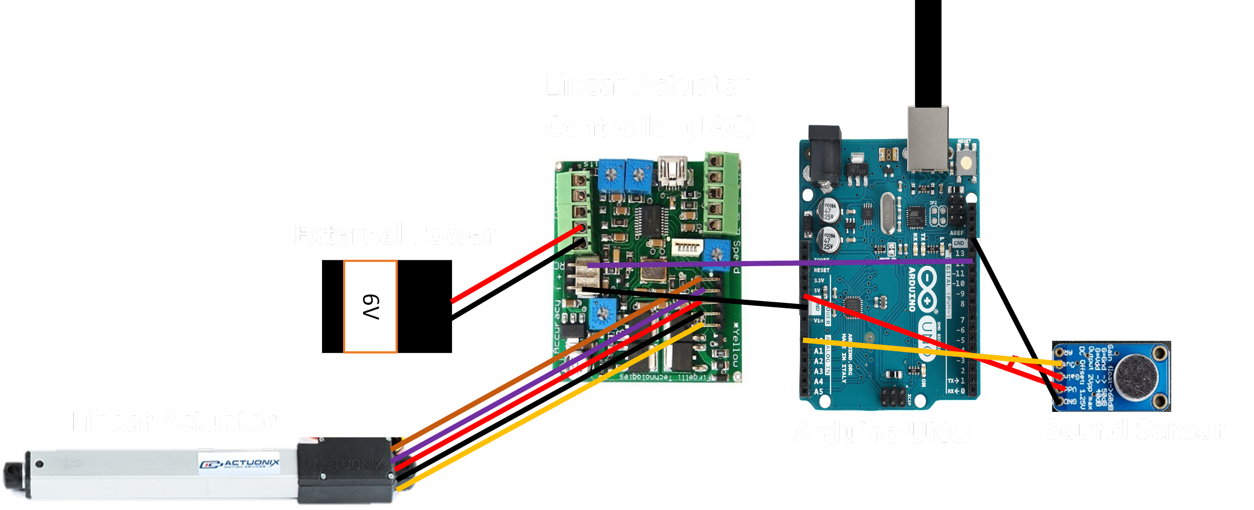
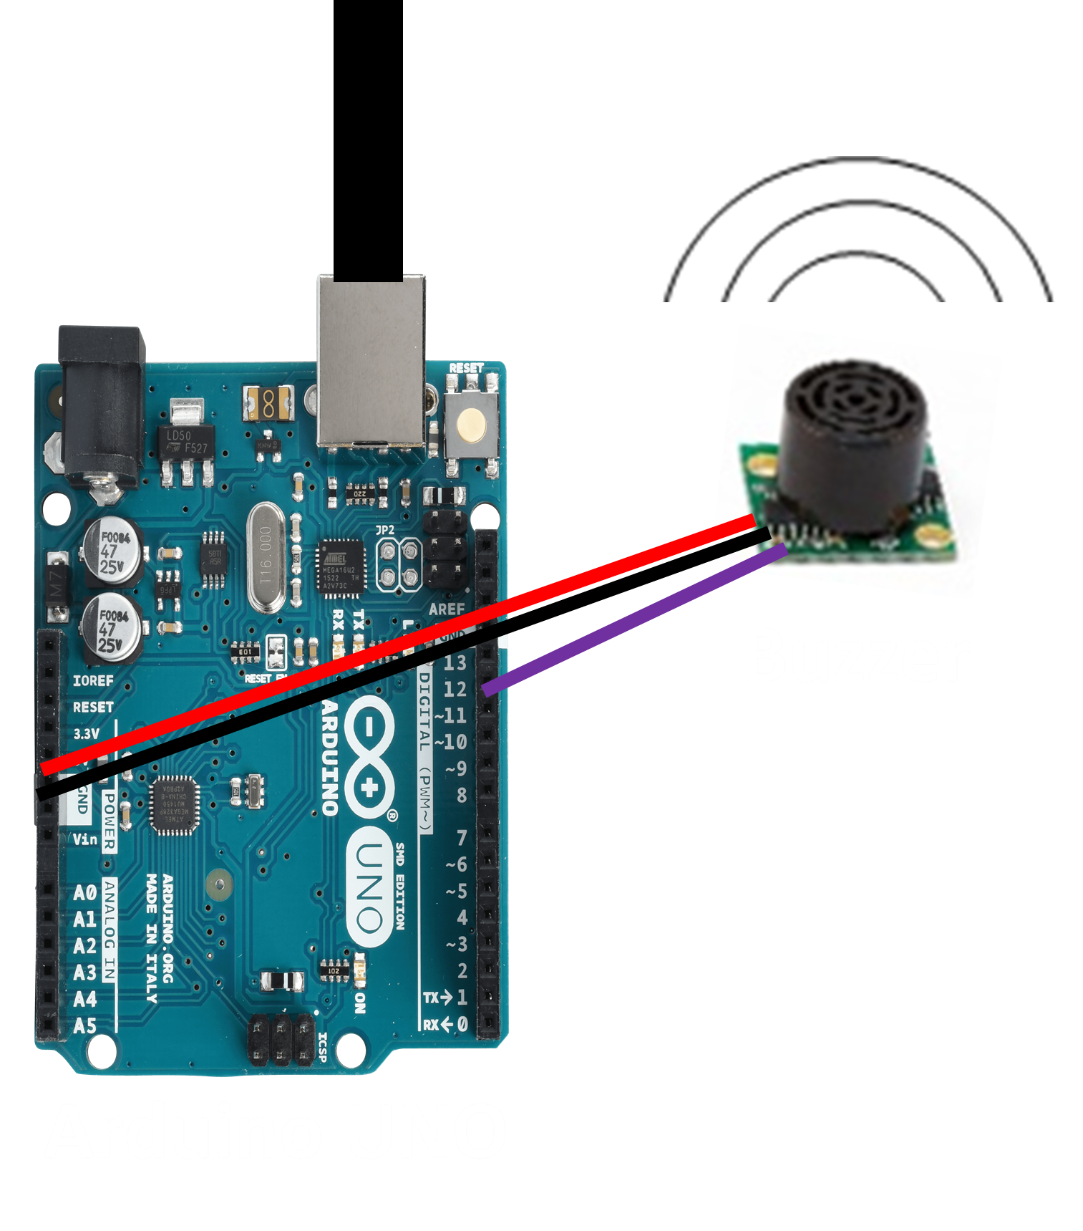
ELECTRICAL COMPONENTS
Notes:
KITHA (Analog sensors that are used to sense sound level are called as sound sensors. These analog sound sensors translate the amplitude of the acoustic volume of the sound into an electrical voltage for sensing sound level. This process requires some circuitry, and utilizes microcontroller along with a microphone for creating an analog output signal.).

Slide 27
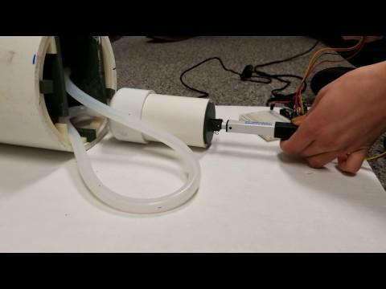
Notes:
KITHA! BETTER VIDEO WITH PISTON CYLINDER

Slide 28
PARTS LIST
Part | Quantity | Price
6’’ PVC PIPE | 1 | $10.00
6’’ PVC Pipe Caps | 2 | $6.00
Arduino UNO | 2 | $44.00
Actuator | 1 | $70.00
Sound sensor | 1 | $7.00
Piezo Buzzer (6-16V) | 1 | $4.00
O-Rings | 4 | $18.00
Barbed Fitting | 2 | $17.00
¼-inch Tubing | 5 ft | $17.00
3-D Printed Items | 39.238 in³ @ $1.33/in³ | $53.00
TOTAL |  | $246.00
Notes:
KITHA Don’t read through this. Just say we’re under budget.

Slide 29
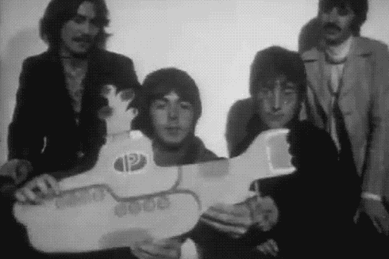
THANK YOU!

